Slide 1







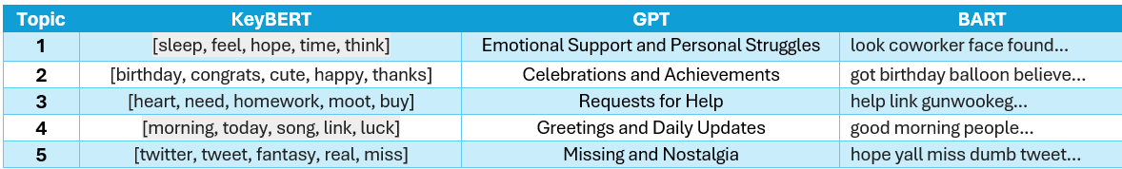
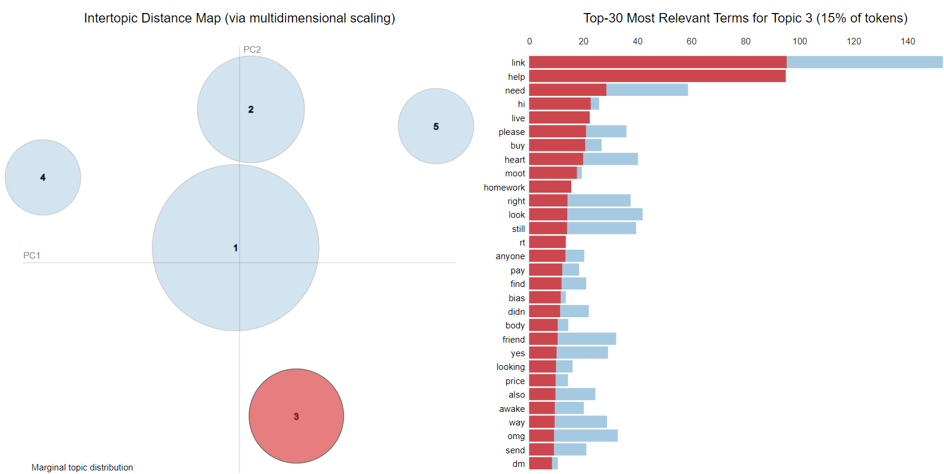
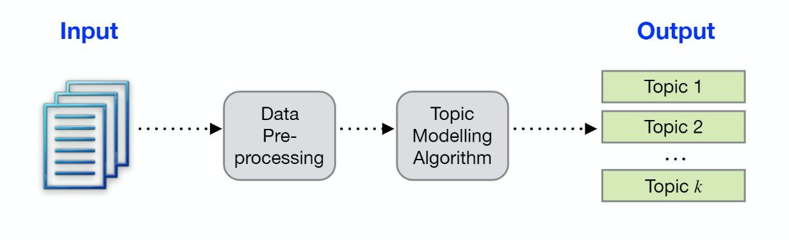





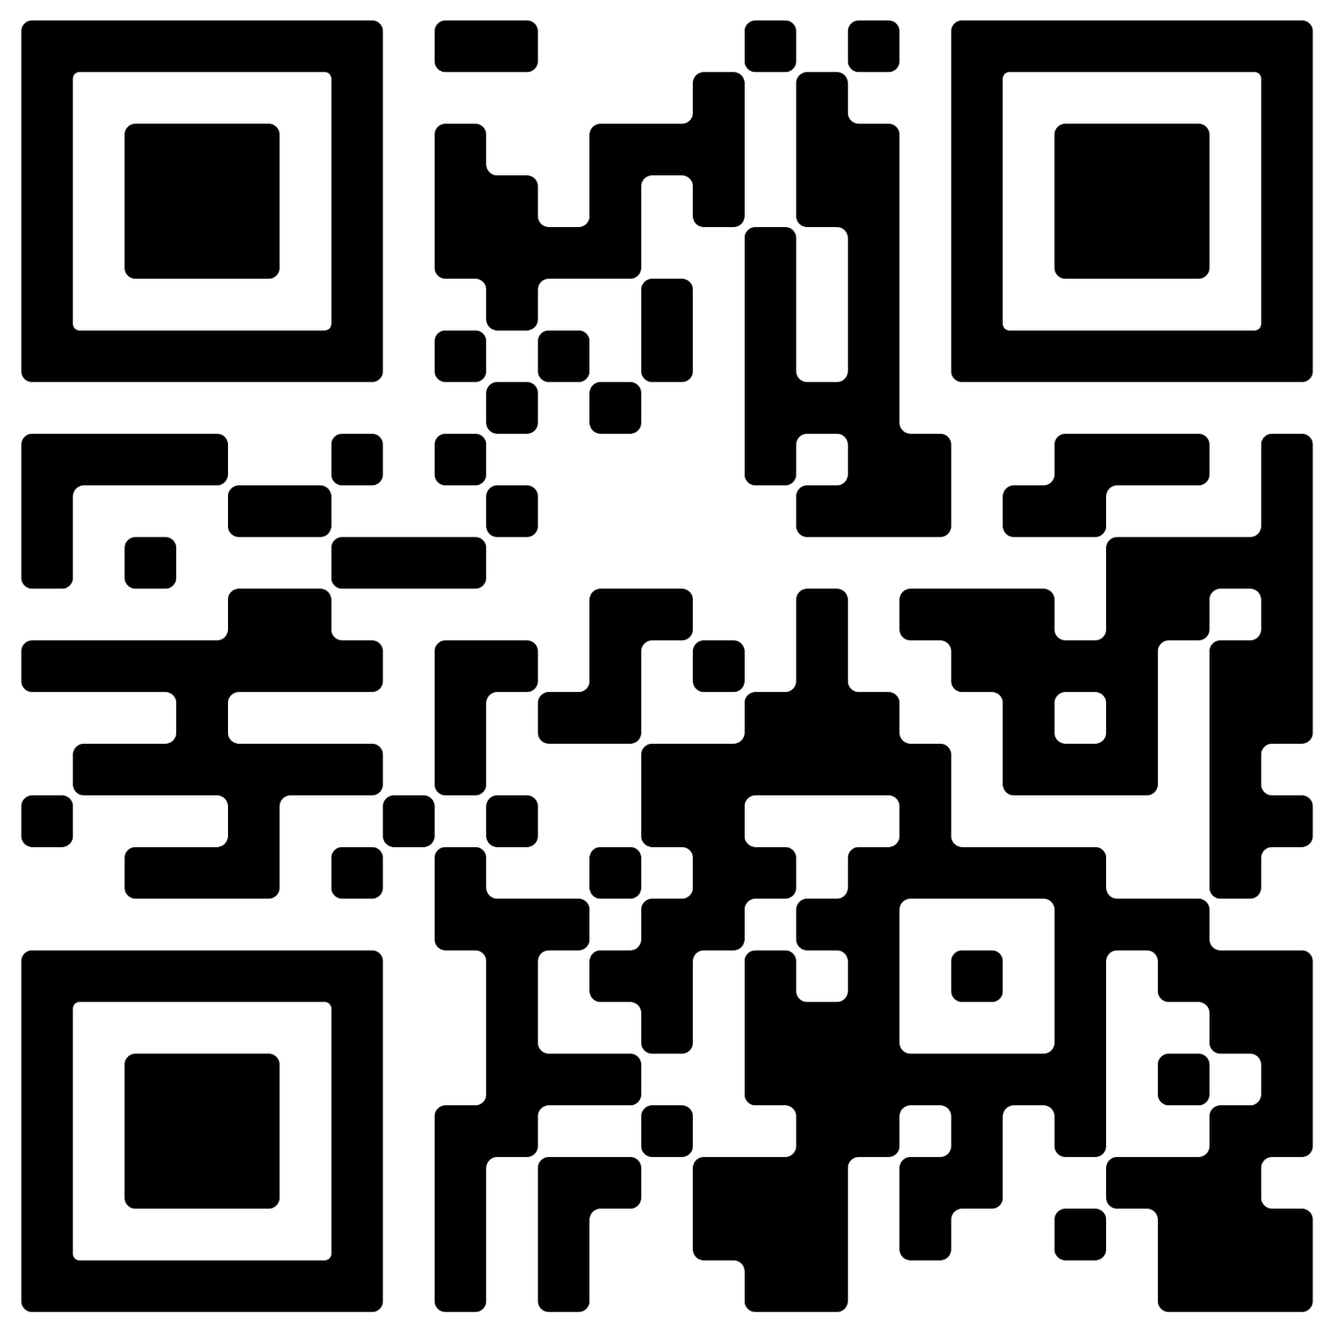



Analysing Social Support in K-Pop Fandoms on Social Media Using Topic Modelling and Large Language Models
Aditi Satsangi, Dr. Stacey Scott and Dr. Ritu Chaturvedi, School of Computer Science, University of Guelph
Introduction
Methodology
Results
We identified five topics related to social support. Among these, emotional support is the most predominant in the text.
Social media platforms like Twitter and Reddit have become vital platforms for online discussions particularly within K-pop fandoms. We extracted the data from twitter and reddit both.
This research uses topic modelling and natural language processing techniques to understand emotions, opinions and social support within these fandoms [1]. LLMs are used to represent results of the topic models.
1. Data Collection
Collected Reddit data using PRAW (web crawler)
Collected Twitter data related to K-pop fandoms using Twitter API
Table 1: The Coherence Scores for different Topic models used
2. Data Pre-Processing
Linked conversations using conversation IDs
Cleaned data: removed emojis, hashtags, special characters, and fandom names; translated non-English text to English
Converted text to lower case
Performed tokenization, stop word removal and lemmatization
Applied Keyword filtering
Model comparisons: NMF performed best, achieving the highest coherence score of 0.656.
Background
K-pop is a form of popular music originating in South Korea as part of South Korean culture.
Topic Modelling is a statistical technique which is used to discover latent topics that exist within a collection of documents.
Large Language Models (LLMs): AI models trained on vast text data to understand and generate human language, used in content creation.
Table 2: Results from Representation Models for NMF Model
3. Text Representation
Term Frequency-Inverse Document Frequency (TF-IDF) used to represent text
This transformed raw text into numerical format for analysis
4. Topic Modelling
Applied three topic models for extracting topics from the text data:
Latent Dirichlet Allocation (LDA)
Non-Negative Matrix Factorization (NMF)
Latent Semantic Analysis (LSA)
Data Description
Twitter:
Post 1: it's been a really rough day for me mentally so i just want to thank all of you who gave me birthday wishes today. i think i would go crazy without you guys. all i can do is hope tomorrow is better. i love you guys
Response 1: i love u and i hope things get better for you soon Response 2: love u more than u know my jaspie 🩷<gif> Response 3: we love you too pup 💗
Response 4: we love you pup! tomorrow is going to be better and we will ALL always be behind you 100% ! be kind to yourself you deserve it <gif>
5. Evaluation
Calculated coherence score for comparison of different topic models
Used metrics perplexity (LDA), reconstruction error (NMF), and singular values (LSA)
Visualized results with pyLDAvis for NMF (see Fig. 1).
Fig 1: Visualization of clusters obtained from NMF model using pyLDAVis
Future Work
We can apply pre-trained models (Transfer Learning) to enhance performance.
We can validate the dataset by manually labeling a small subset to ensure accuracy and quality.
6. Representation using Large Language Models (LLMs)
Employed LLMs for result interpretation:
KeyBERT: Keyword extraction for each topic
BART: Topic Summarization
GPT: Topic labelling
Reddit:
Post 1: Hi everyone! I joined an Sf9 album group order and a fan call was up to win and I won!! I was told I can pick which member I can talk to and I’m planning to talk to Zuho. I never did a kpop fan call and I’m just wondering how does it work? Do y’all have experiences or advice? ☺️
Response 1: I have no idea but I'm so happy for you! Have a great time 😭❤what is this pc from? i got it as a random freebie from kpopusa
Response 2: Omg I'm so happy for you! How was your experiences with other members too?
References
[1] Egger, Roman, and Joanne Yu. "A topic modeling comparison between lda, nmf, top2vec, and bertopic to demystify twitter posts." Frontiers in sociology 7 (2022).
Scan this code to access this poster and citations and suggestions/ feedback form
School of Computer Science
University of Guelph
CARE-AI
University of Guelph

